Slide 1
Crosstalk on Signal-Return Loops Adinath Phene, Shrinithi Venkatesan
February 29, 2024

Slide 2
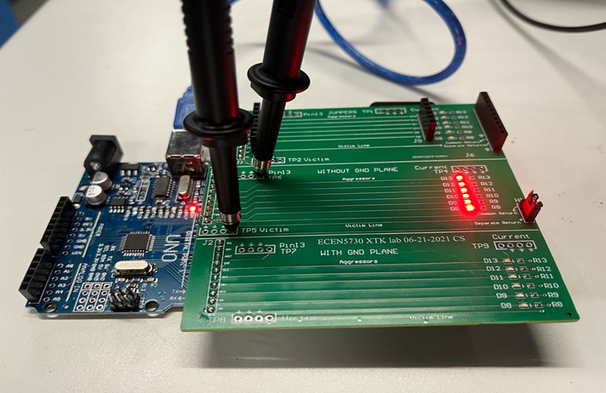
Agenda
What is Crosstalk?
Different Return Path Geometries
Varying No. of Aggressors
Best Design Practices

Slide 3
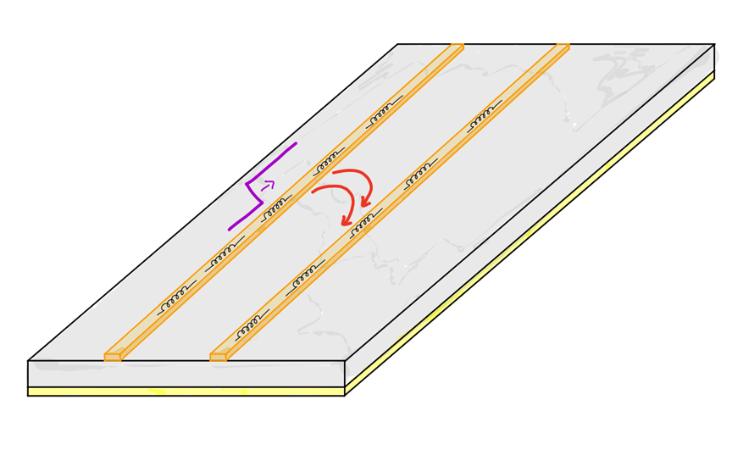
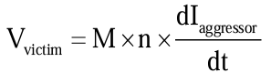
Crosstalk
Changing current in the aggressor loops creates changing magnetic field.
Changing Magnetic field in Aggressor Loop induces voltage in the victim line.
Aggressor Trace
Victim Trace
M = mutual loop inductance between Aggressor & victim loops
n = Number of simultaneously switching aggressors
= current change in each aggressor
dt = rise or fall time of the aggressor

Slide 4
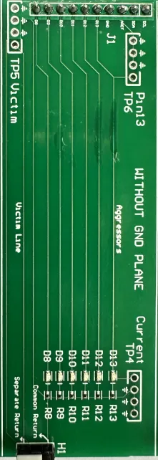
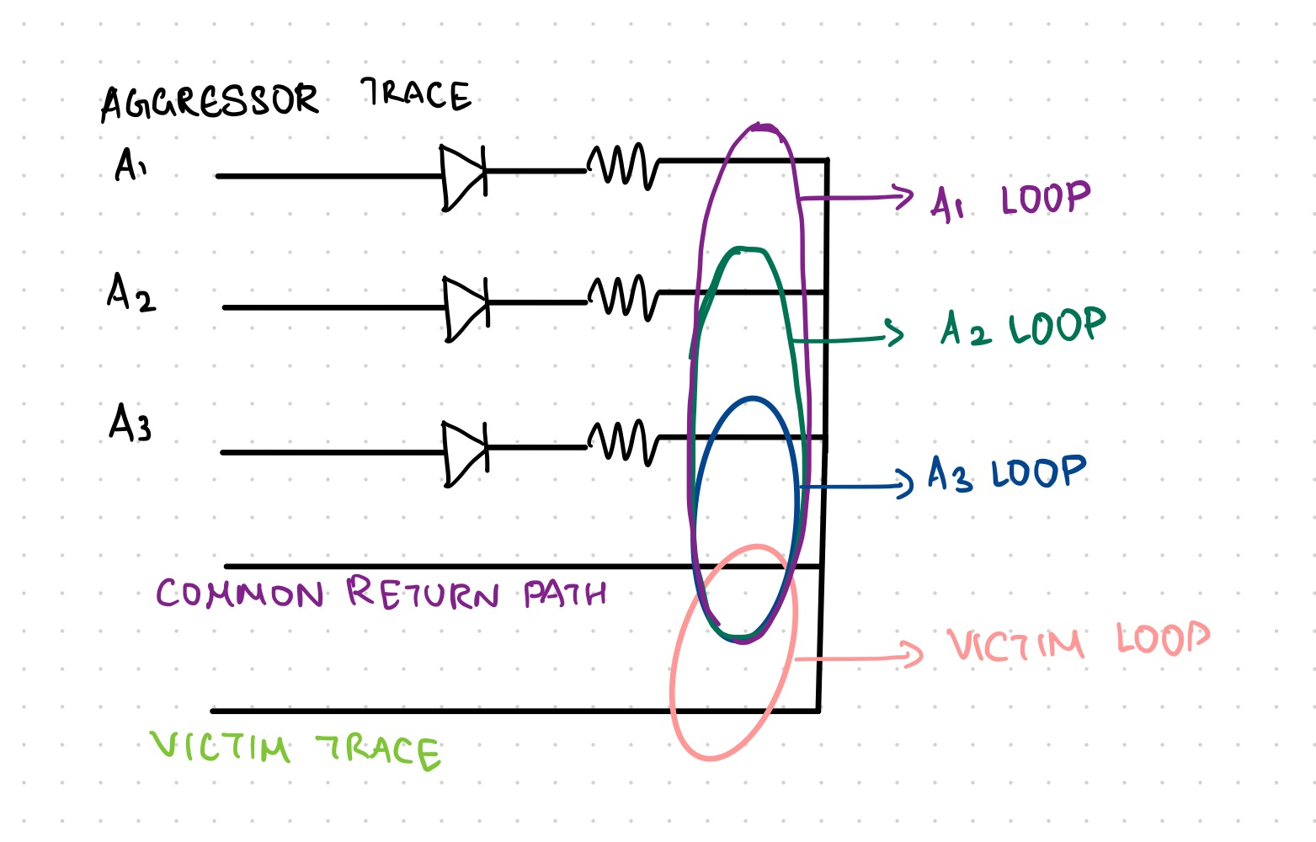
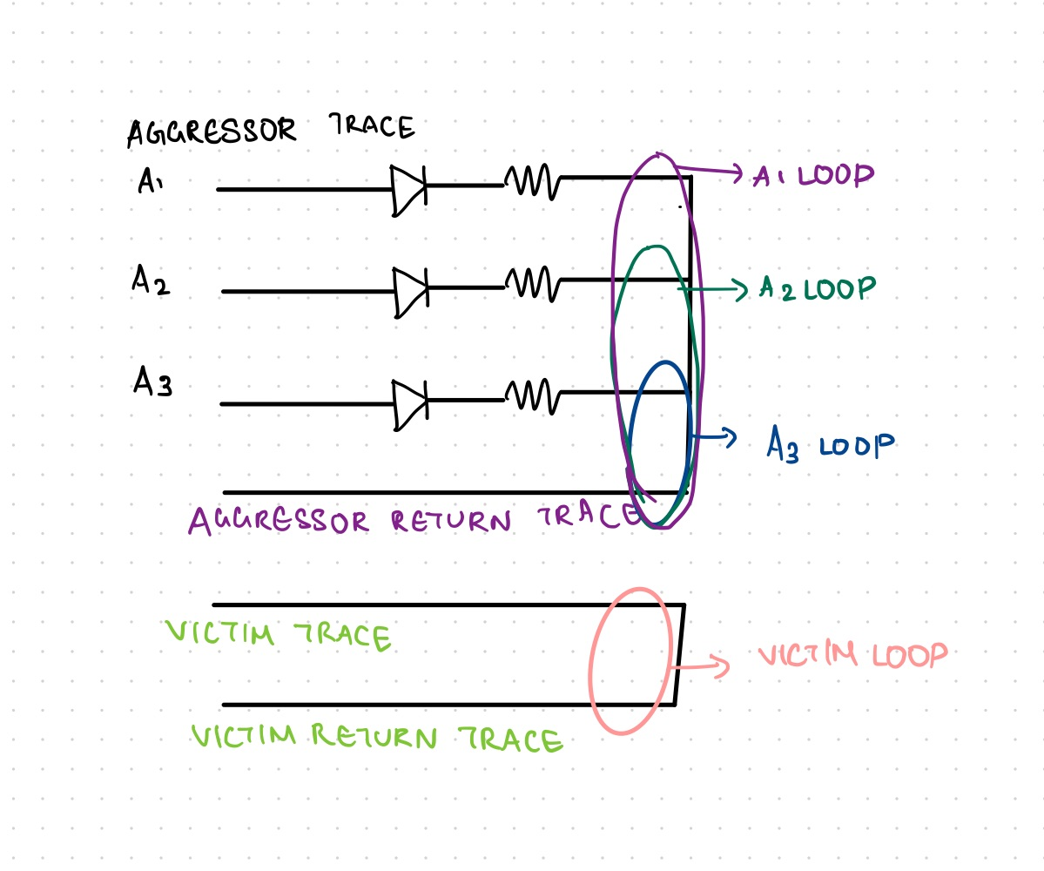
Shared & Separate Return Traces
Continuous Return Trace
Separate Return Trace
Equivalent circuit
Equivalent circuit
Use a 10x probe
Use spring tips

Slide 5
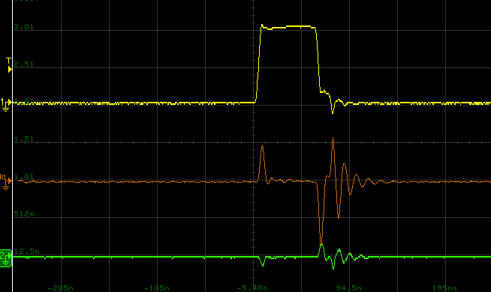
Crosstalk with Common & Separate Return Traces
Horizontal Scale: 50ns/ div
Return Path Geometry | Crosstalk (in mV)
Common Trace | 870
Separate Traces | 180
Trigger at Pin 13
Vertical Scale: 2V/ div
Crosstalk on victim line reduces using separate return trace.
More crosstalk observed on the falling edge as compared to the rising edge.
Vertical Scale: 500mV/ div
Crosstalk on Victim
455 mV
Common Return Trace
870 mV
Vertical Scale: 500mV/ div
Crosstalk on Victim
Separate Return Trace

Slide 6
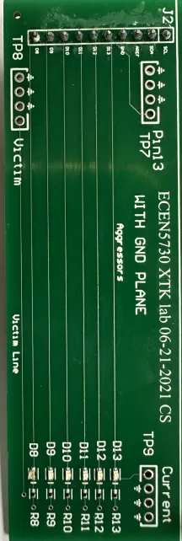
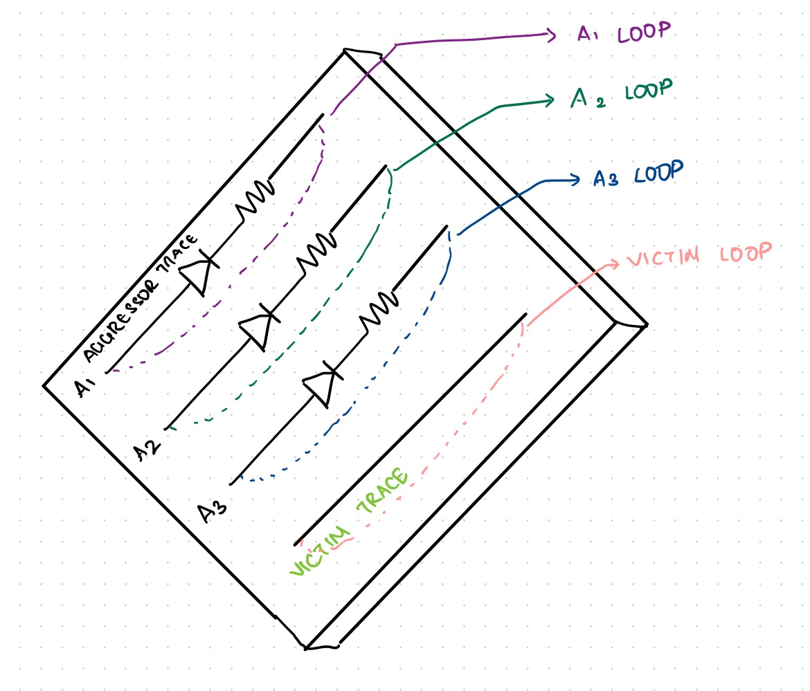
Continuous Return Plane

Slide 7
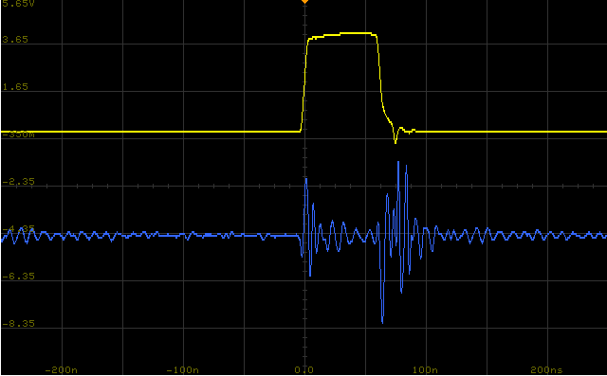
Crosstalk with Continuous Return Plane
Horizontal Scale: 50ns/ div
Return Path Geometry | Crosstalk (in mV)
Common Trace | 870
Separate Traces | 180
Continuous Return Plane | 18
Trigger at Pin 13
Vertical Scale: 2V/ div
Vertical Scale: 10mV/ div
Continuous return plane shows least crosstalk on the victim line.
Best design practice to have continuous return plane in PCB.
12.5mV
Crosstalk on Victim
18 mV

Slide 8
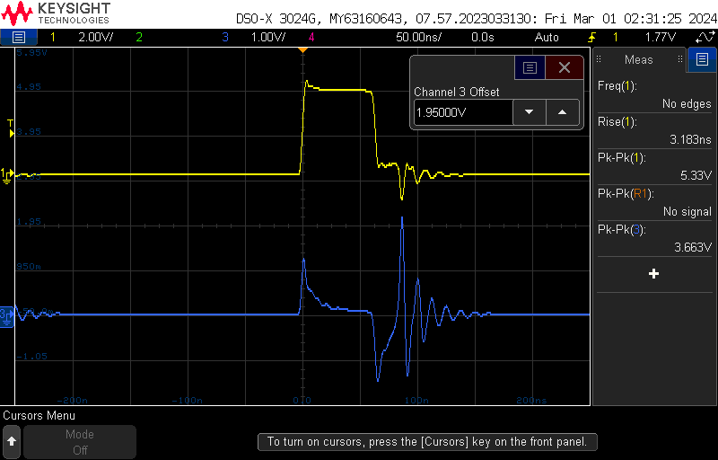
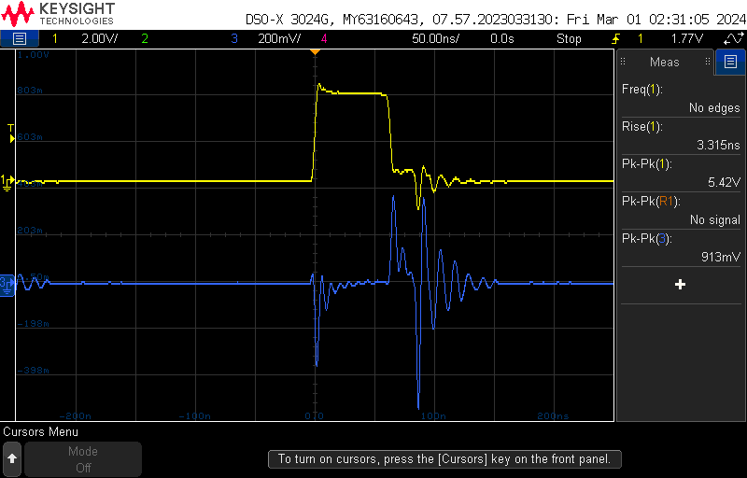
No. of Simultaneously Switching Aggressors
Horizontal Scale: 50ns/ div
Horizontal Scale: 50ns/ div
Trigger at Pin 13
Trigger at Pin 13
Vertical Scale:
2V/ div
Vertical Scale:
2V/ div
350 mV
Crosstalk on Victim
Vertical Scale:
1V/ div
1.2 V
347 mV
Vertical Scale:
200mV/ div
Crosstalk on Victim
1.6 V
Common Return Trace
Separate Return Traces

Slide 9
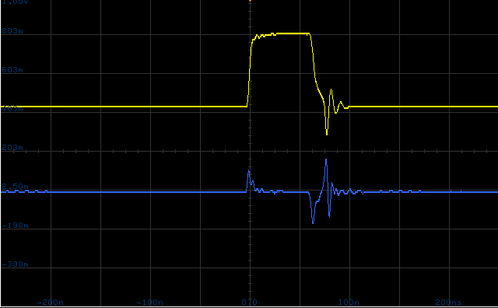
No. of Simultaneously Switching Aggressors
Horizontal Scale: 50ns/ div
Return Path Geometry | Crosstalk (in mV) | Crosstalk (in mV)
Common Trace | 870 | 1600
Separate Traces | 180 | 350
Continuous Return Plane | 18 | 163
Trigger at Pin 13
Vertical Scale:
2V/ div
128 mV
Crosstalk on Victim
Vertical Scale:
200mV/ div
163 mV
Crosstalk increases with increase in the number of aggressors.
Continuous return plane shows least crosstalk on the victim line.
Continuous Return Plane

Slide 10
Best Design Practices to Reduce Crosstalk:
Do not share return paths between the signal-return loops of the aggressor and victim. Use a separate return conductor.
Reduce the loop mutual inductance between aggressor and victim signal-return paths by keeping the loops far apart.
Reduce the number of simultaneously switching signals which have mutual inductance to the victim loop.
Use a Continuous Return Plane on a PCB to reduce the self-inductance in the signal-return path and mutual loop inductance between aggressor and victim traces.

Slide 11
Questions?

